Slide 1

Hotel’s Customer Segmentation
EDA & RFM Analysis

Slide 2
Background
Project task statement

Slide 3
Project Task Statement
A four(4) star hotel located in Lisbon, Portugal, Europe gathered customer's data during 2015 to 2018 period. The data contains several information related to Hotel's bookings by Customer during the period.
The goals of this project are:
Do EDA to gain insight from the several aspect of customer behavior,
Do RFM analysis for customer's segmentation classification, and
Recommendation of action based on Customer Behavior.

Slide 4
Data Source
Brief explanation of data source used

Slide 5
Data Source
Data is gathered from a 4 stars Hotel located in Lisbon, Portugal, Europe.
Period of data is from 2015 – 2018
Contains 31 variables and 83,590 records, each records for each customer
Data is available from http://dx.doi.org/10.17632/j83f5fsh6c.1 or https://www.kaggle.com/nantonio/a-hotels-customers-dataset.
More about data source: https://www.sciencedirect.com/science/article/pii/S2352340920314645?via%3Dihub

Slide 6
EDA
Exploratory Data analysis

Slide 7
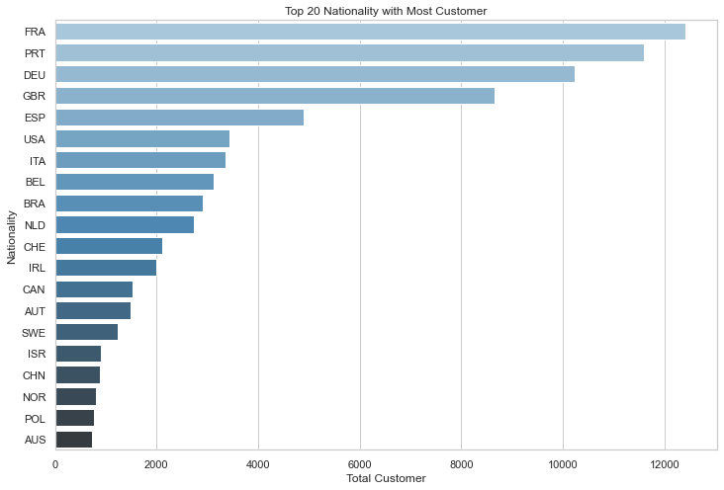
Top 20 Nationality with Most Customer
France, Portugal, Germany, United Kingdom of Great Britain and Northern Ireland, and Spain in order are the most Customer's Nationality come from.

Slide 8
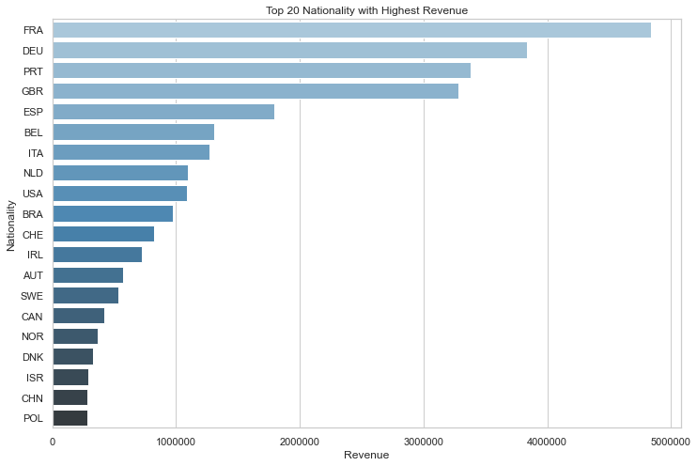
Top 20 Nationality with Highest Revenue
France, Germany, Portugal,United Kingdom of Great Britain and Northern Ireland, and Spain in order are the Nationality with highest revenue.

Slide 9
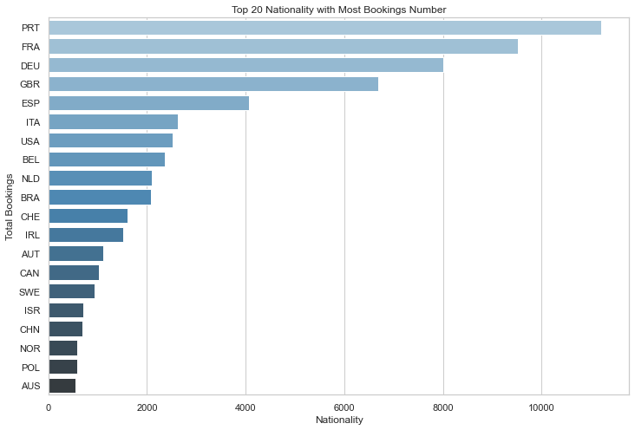
Top 20 Nationality with Most Bookings Number
Portugal, France, Germany, United Kingdom of Great Britain and Northern Ireland, and Spain in order are the Nationality with most booking number.

Slide 10
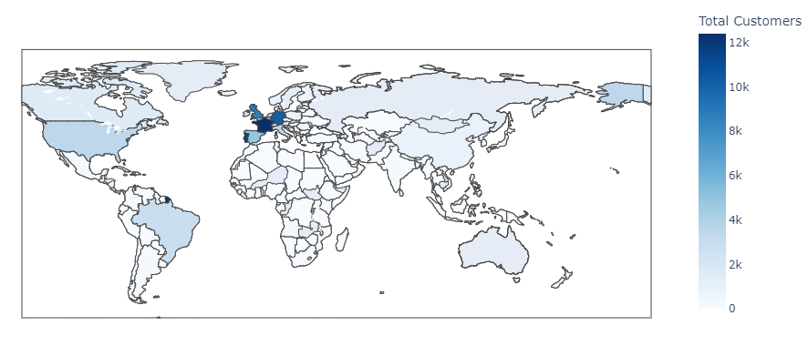
Total Customer by Nationality
Most of Customers comes from Europe Region

Slide 11
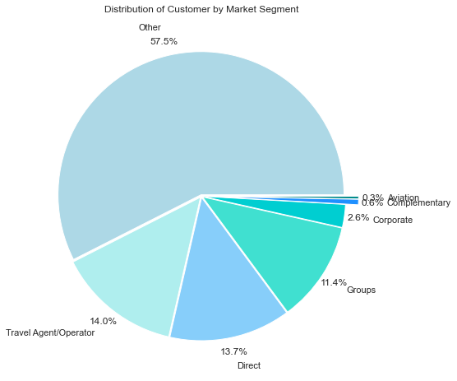
Customer Distribution by Market Segment
Most of the customer come from:
Other Market Segment (57.5%), followed by
Travel Agent/ Operator(14%) and
Direct(13.7%).

Slide 12
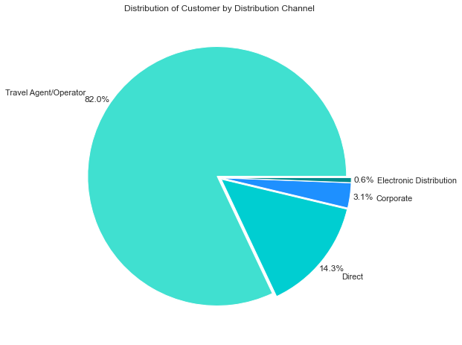
Customer Distribution by Distribution Channel
Most of the customer use :
Travel Agent/Operator channel (82%), followed by
Direct(14.3%),
Corporate(3.1%) and
Electronic Distribution (0.6%).

Slide 13
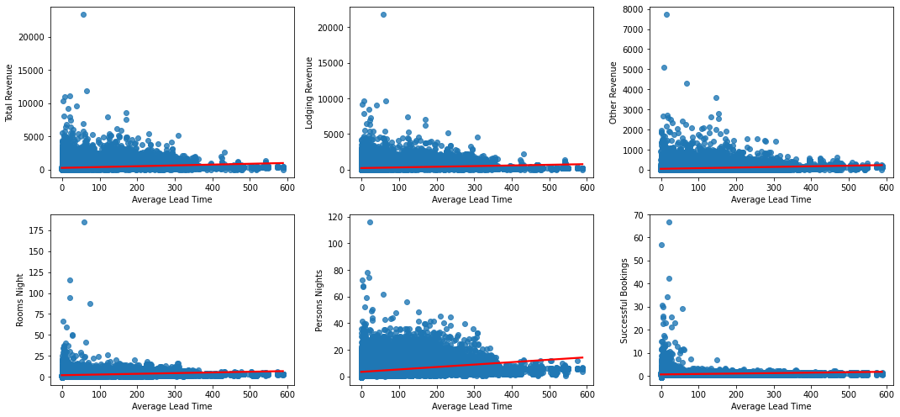
Correlation of Average Lead Time
There is no strong correlation between Average Lead Time and Lodging Revenue,Total Revenue, Other Revenue,Rooms Nights, Persons Nights and Successful Bookings.

Slide 14
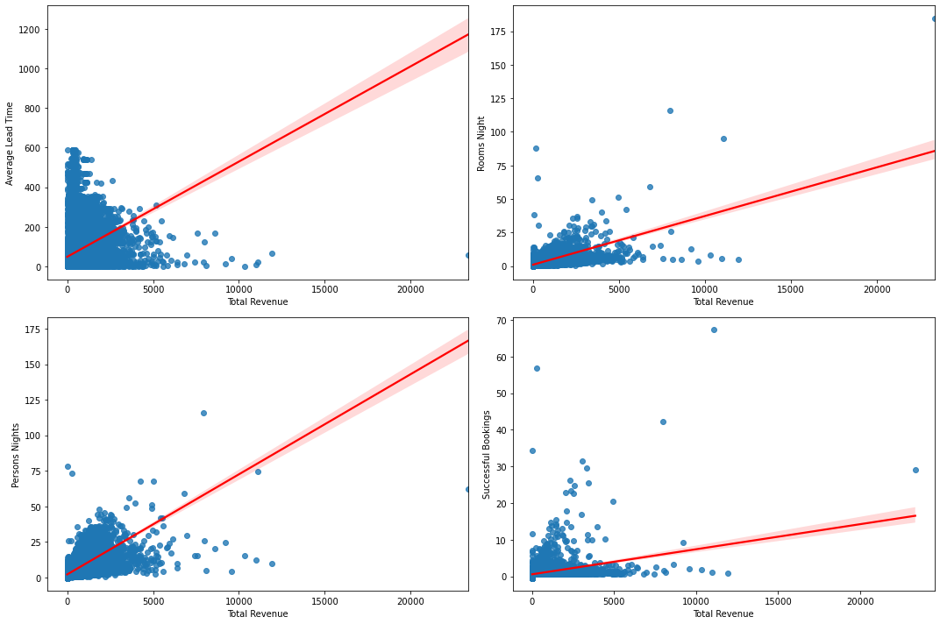
Correlation of Total Revenue
There is slightly strong correlations between Total Revenue with Persons Nights, Successful Bookings and Rooms Nights.
Customer with high total revenue tend to books with more Persons Nights and Rooms Nights

Slide 15
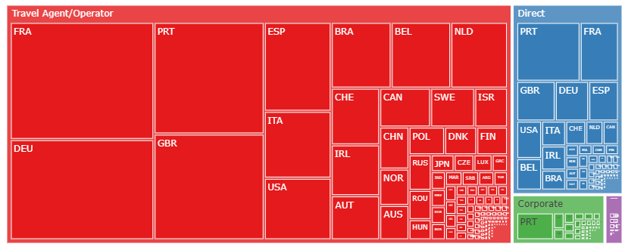
Customer Population Mapping
Customer population classified by Nationality and Distribution Channel they used.

Slide 16
RFM
Recency, frequency, monetary

Slide 17
Method of Analysis
With the existing data, we use several variables (columns) for scoring references, such as:
Month Since Last Arrival for Recency Score
Successful Bookings for Frequency Score
Total Revenue for Monetary Score

Slide 18
Scoring method
Dividing the values of each “Month Since Last Arrival” & “Total Revenue” variables based on their distribution value
Because of distribution pattern, “Successful Bookings” variable cannot be grouping based on its distribution value, so we classified by several value instead.
Each category divided into 3 groups of score (1-3)
Recency | Frequency | Monetary
1 (1st percentile, absence for long time) | 1 (0 – 1 successful bookings) | 1 (1st percentile, spend a little)
2 (2nd percentile, its already a while) | 2 (2 – 4 successful bookings) | 2 (2nd percentile, spend average)
3 (Most recent, 3rd percentile) | 3 (> 4 successful bookings) | 3 (3rd percentile, big spender)

Slide 19
Customer Segmentation
Each Customer will be clustered based on their RFM Score
Segment | RFM Score | Description
Best Customer | 333 | Bought most recently, most often, and spend the most
Loyal Customer | X3X | Buy most frequently
Big Spender | XX3 | Spend the most
Almost Lost | 23X | Haven't purchase for some time, but purchased frequently
Lost Customers | 13X | Haven't purchase for some time, but purchased frequently
Lost Cheap Customers | 111 | Last purchased long ago, purchased few, and spend little

Slide 20
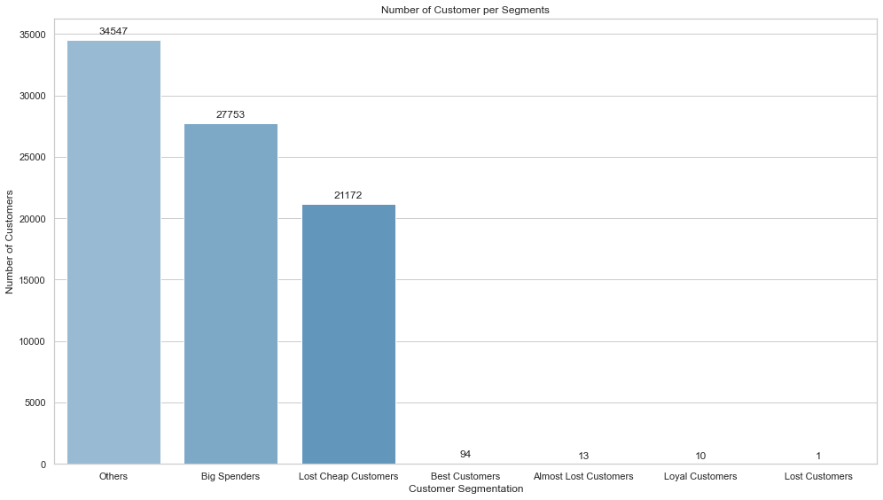
Number of Customers per Segment
Most of Customer categorized as Others Segment
27,753 Customer categorized as Big Spender
21,172 Customer categorized as Lost Cheap Customer
The population of the rest segments are very low.

Slide 21
Conclusion
Insight & Recommendation

Slide 22
Insight
From the analysis, we got some points:
Most of the customer, bookings and revenue come from European region, which same region with the Hotel location. The customer from the other region probably less frequent to stay at the Hotel.
Travel Agent/ Operator is the Distribution Channel mostly used by customers while Electronic Distribution is the least.
The number of loyal customer is so low at this point, while the number of Customers categorized by Others and Lost Cheap Customers is very high.
Most customers only 1 times stay and the customers who stay frequently is very rare compared to customers who frequently stay at the Hotel

Slide 23
Recommendation
For the better sales at the future, there are several method for sales & marketing program to be evaluate later:
Company can create campaign for those 1 time stay Customer to become loyal customer such as discounted price on holiday occasion or business trip campaign.
Since Travel Agent/ Operator is the Distribution Channel most used by customers, company should increase campaign engagement by Travel Agent/ Operator channel.
Furthermore, Electronic Distribution is a things people access almost every time, engagement from Electronic Distribution can be useful for gaining engagement.
For future analysis, we need to know the period when the customer usually stay at Hotel, to know the effective timing to start campaign.

Slide 24
Thank you

